Slide 1
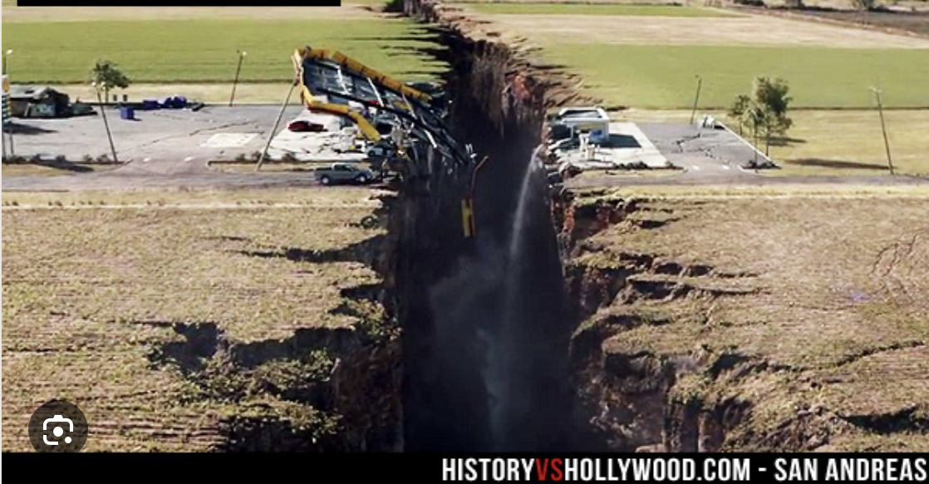
One Nation, Two Realities: The Science of Misinformation and Political Polarization
Notes:
I'm honored to be here. I was so pleased to be invited to talk about this topic, really interrelated topics of misinformation and our deep political divisions.
I think this is not just fascinating but also has been creating a deep undercurrent of trouble in the last few years.

Slide 2
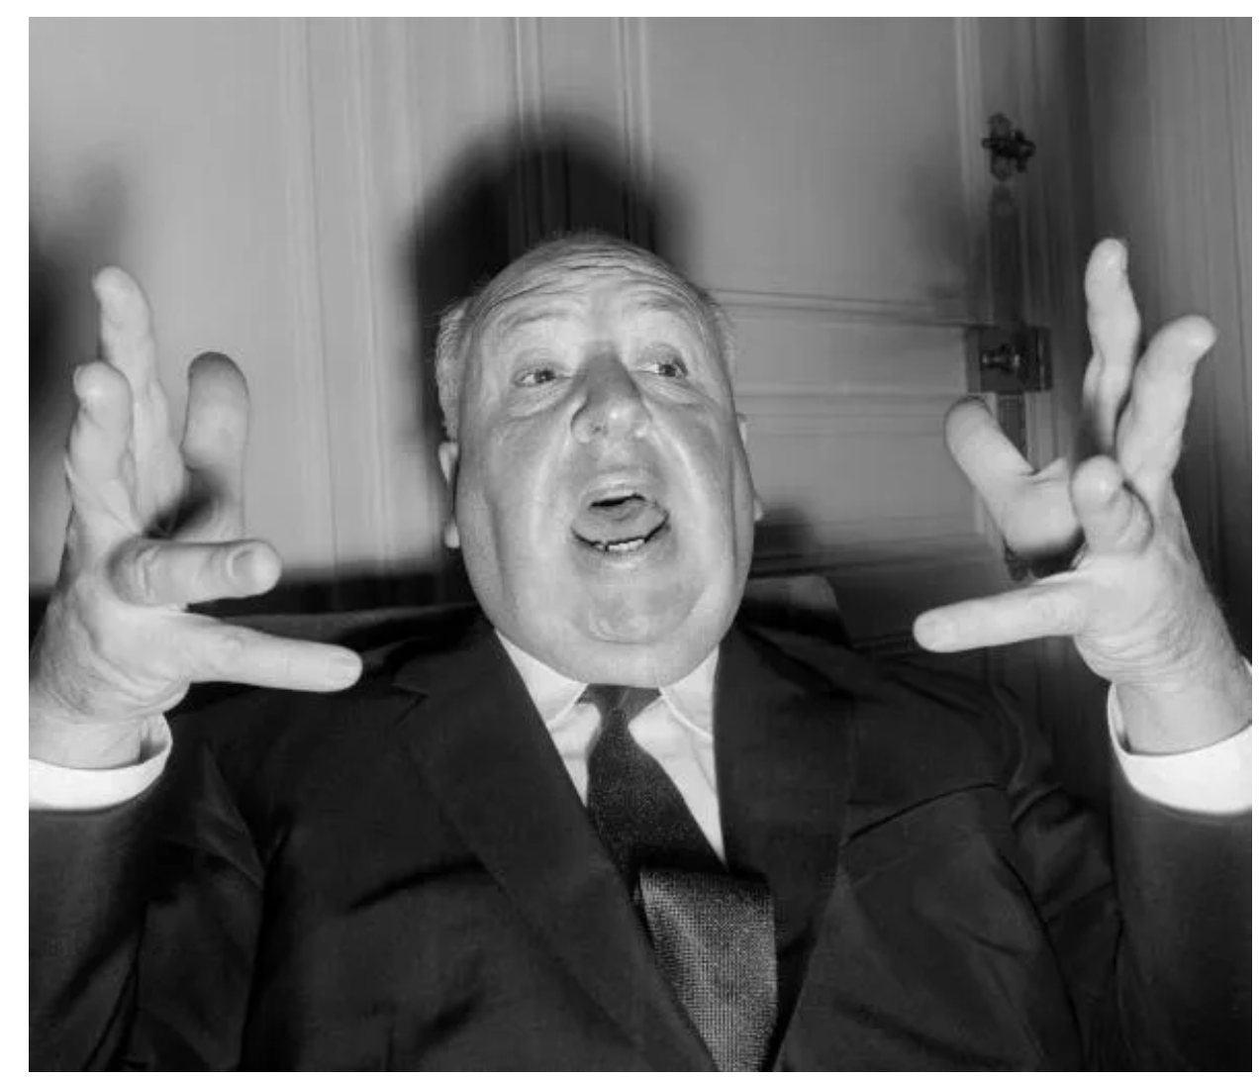
My view as a science journalist covering misinformation through three very contentious elections and one global pandemic
What scientists have learned about misinformation, how it circulates and how it affects us.
Solutions: How can Americans become better informed? What works and what doesn’t?
AA AA
Notes:
My experience as a journalist - trying to avoid spreading misinformation while covering really complex topics....
And I'd like to delve into the science of misinformation - which is something I've been covering for the last few years.
*what kinds of misinformation are most believable*what's the relationship between polarization and misinformation.

Slide 3
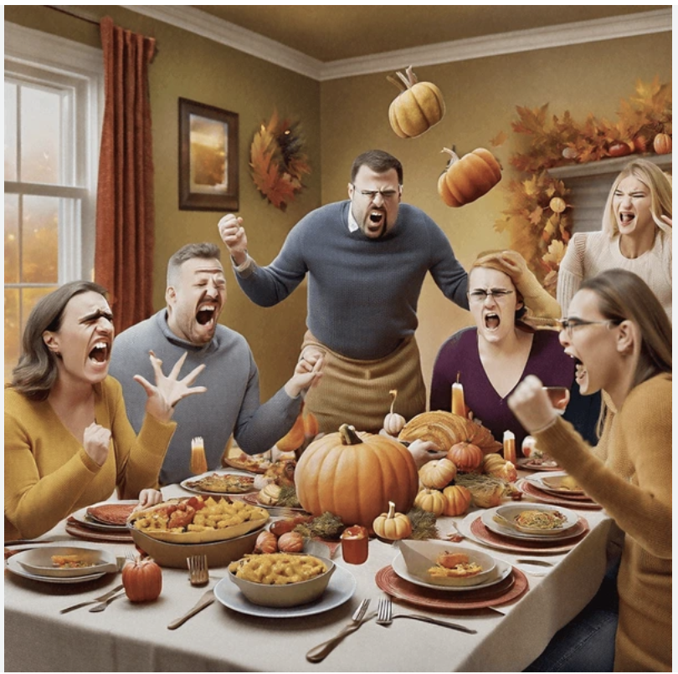
How was your Thanksgiving?
Surveys show Americans are now more likely to align all our views to the left or right.
It really is harder to talk about current events with people on the other side.
Notes:
Did anyone have people from opposite sides of our political divide at Thanksgiving? Could you talk about current events.
Surveys show people are less likely to be liberal on one issue and conservative on the other - so we're disagreeing in a different, more personal way.

Slide 4
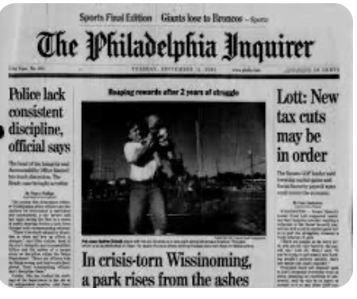

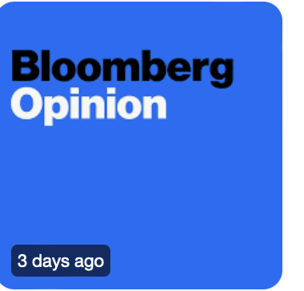
Some Places I’ve Worked As a Journalist
Notes:
Bloomberg - covered all areas of science, including social sciences, and misinformation was a general topic people were very concerned about - I wanted to be part of it. Almost anything can be covered from scientific perspective.

Slide 5
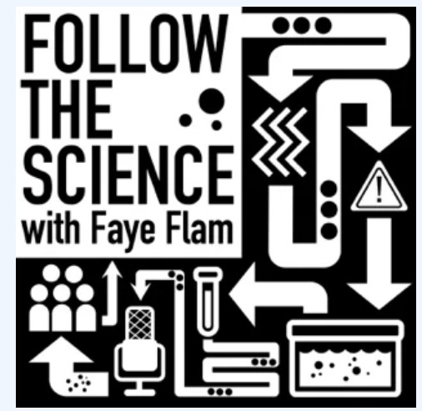
My Podcast Project Sponsored by the Society for Professional Journalists
Notes:
And then we had this pandemic!
I found out about a fellowship from the SPJ which involved a chunk of money to undertake a project.
I proposed medical misinformation which was the topic of the year in 2020.
Created podcast FTS

Slide 6
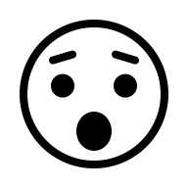
A Few Surprising Things I’ve Learned About Misinformation
Notes:
So let's dive in and talk about some things I learned researching the science of misinformation.

Slide 7
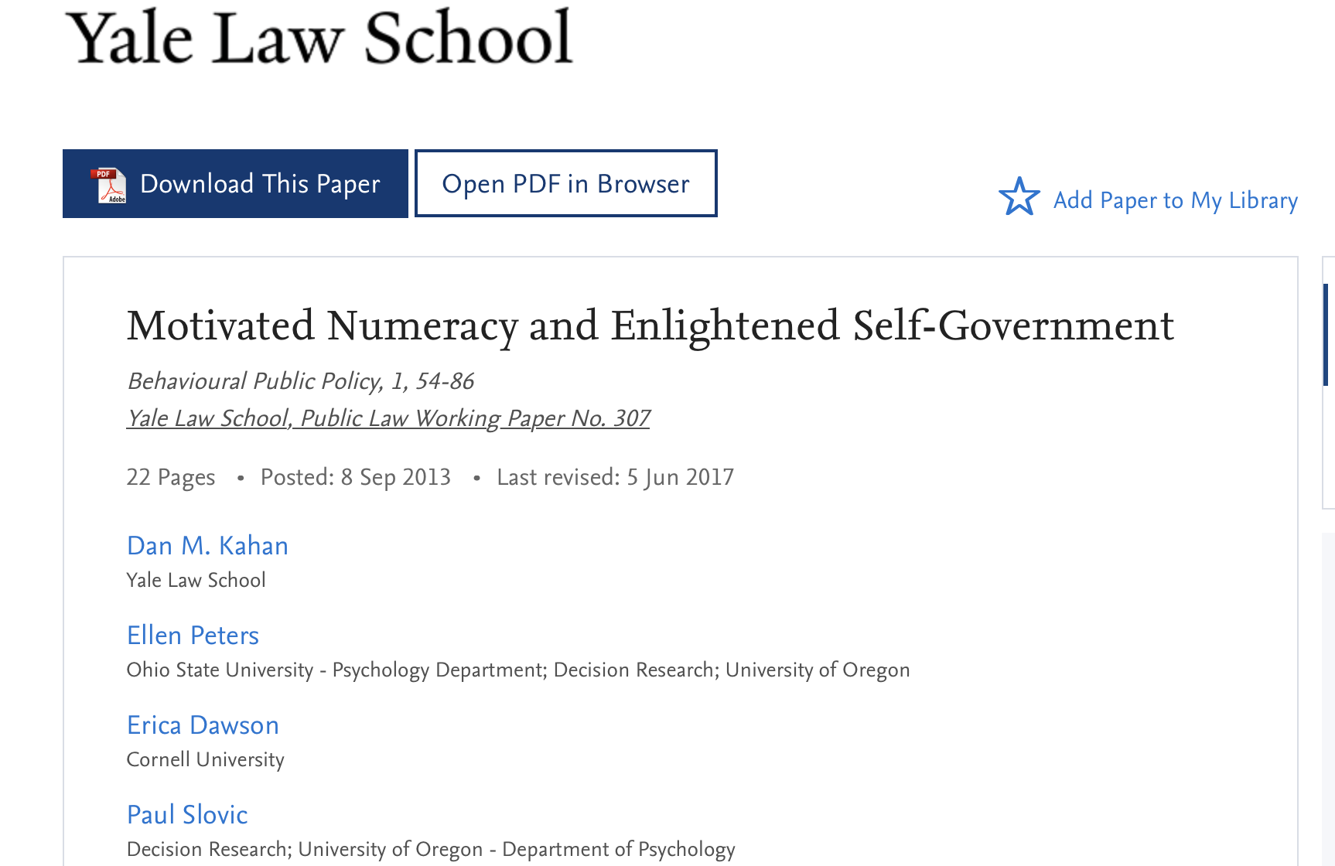
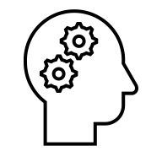
A famous study on the psychology of misinformation – how political beliefs warp reasoning – Dan Kahan et al 2013.
involved, even smart people misread simple f
Notes:
This is a study a lot of people bring up when you mention the science of misinformation. It goes back to 2013 and the lead author, Dan Kahan, is a professor at Yale Law School - so he's an expert on the intersection of behavioral science and law.

Slide 8
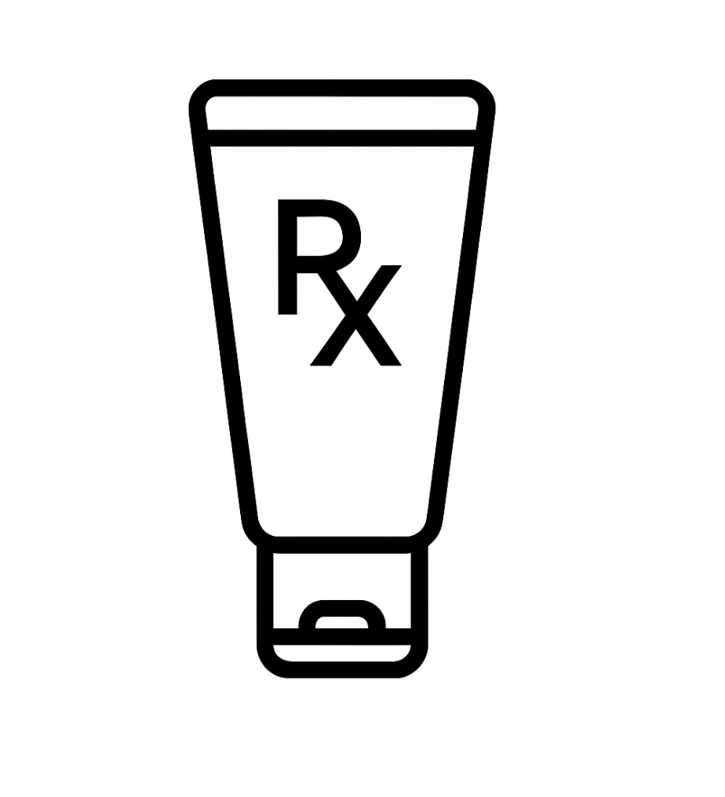
How the experiment worked:
First volunteers were given a test of basic math skills, also known as numeracy. Then they were asked to evaluate two sets of data.
1. The first involved a cream for skin rashes
Participants saw a small table of numbers about the skin cream: - How many people used the cream? - How many improved? - How many did not improve?
Notes:
The way this experiment worked, volunteers were first tested for math skills, also known as numeracy, and then given two sets of data to interpret.
Most people got that right, and the higher the math skills the more likely people were to correctly interpret the data.

Slide 9
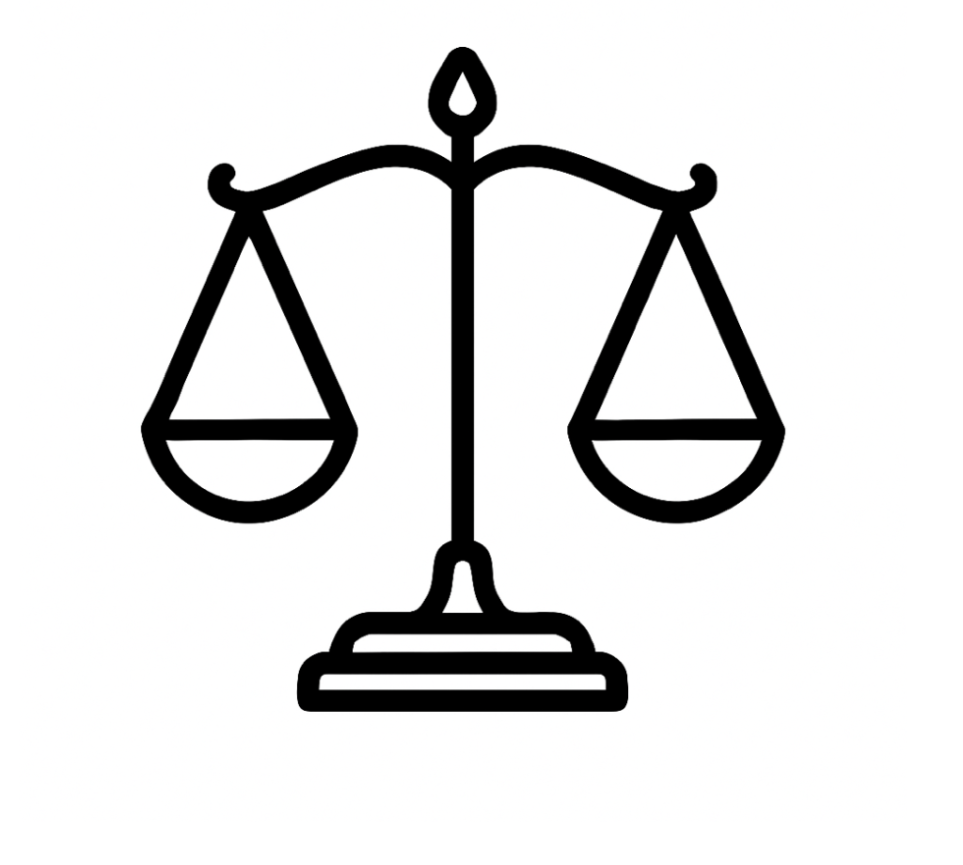
2. Second Task: The Exact Same Numbers… But About Gun Control:
People who got the skin-cream version right now misread the exact same numbers if the correct answer contradicted their political beliefs.
Notes:
Then people got the exact same data but applied to something much more contentious and political: a gun control measure and they were supposed to assess whether it worked.
The math was the same but many of the people who got it right with a skin cream got it wrong.

Slide 10
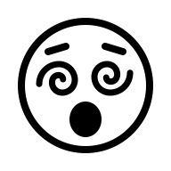
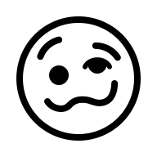

Kahan called this kind of error motivated numeracy, but it became popularly known as motivated reasoning.
The people who scored highest on on the math skills/numeracy test did the worst on the gun control question if the right answer conflicted with their beliefs.
Notes:
People were contorting the data to fit what they already believed. If they thought gun control was important and worked, they'd interpret the data to show this measure worked, whether it did or not. Or if they were against gun control they'd interpret the data to say the measure failed.

Slide 11
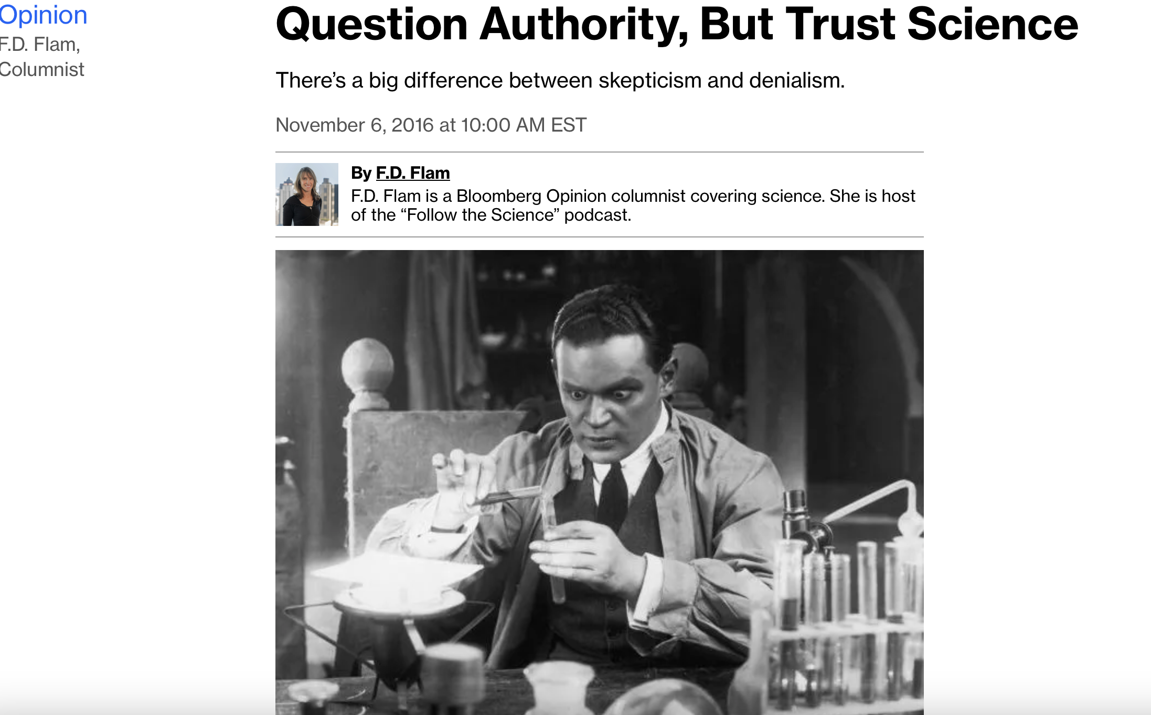
In 2016 I interviewed the author of the motivated reasoning study, Dan Kahan. He had begun studying how people choose positions on complex issues such as climate change. It was all about political alignment. *And there’s a warning here for anyone acting as information police.
Notes:
We talked about trust in scientists and he found that while Americans don't openly dislike scientists, many of them had very selective trust of experts. Conservatives distrusted most climate scientists, for example.
Political affiliation was what drove people's positions on complex science-related issues.

Slide 12
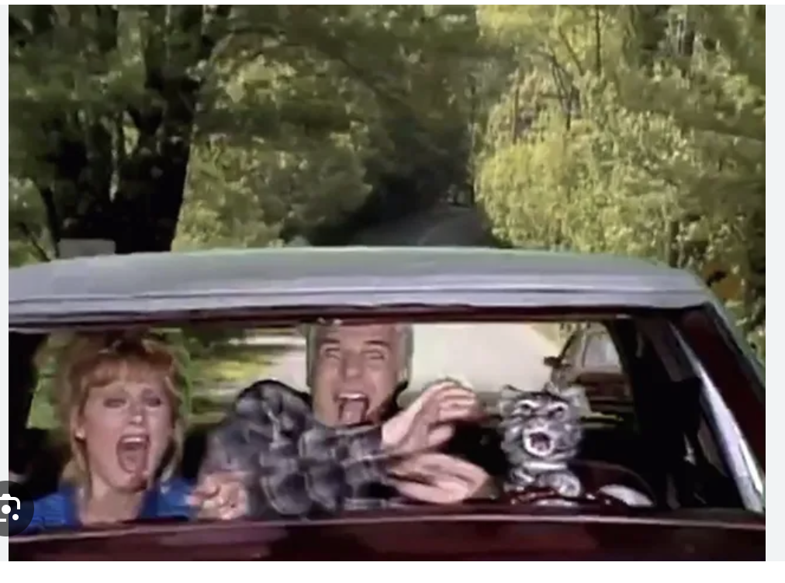
It would be nice if people could be more rational about science-related matters, he said, ”but we live in an environment where these issues have been associated with admission to a group.” That creates a polluted science communication environment. He compares Americans trying to sort out complex scientific issues to the Saturday Night Live character Toonces the Driving Cat: “They can do it, but not very well.” – Interview with Yale Psychologist and law professor Dan Kahan.
Notes:
And this was from an interview right before the 2016 election. Indeed over the next eight years it's been a wild ride!

Slide 13





Over the 2010s, many Americans abandoned newspapers and started getting most of their news from Facebook and Twitter.
By 2016 we were seeing “fake news” stories that looked like they came from real news sites. Pope Francis Endorses Trump, And Hillary Sells Weapons to ISIS. Who is likely to buy into this stuff? Scientists begin to investigate…..
Notes:
People with math smarts are not more likely to fall for misinformation - even if they did engage in more motivated reasoning in the 2013 study.
*But researchers did find a strong correlation to something else - people who got low scores on something called the Cognitive Reflection Test*

Slide 14
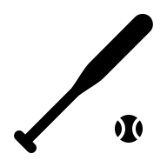
A question from the Cognitive Reflection Test:
A bat costs $1 more than a baseball.
The bat and ball together cost $1.10
How much does the ball cost?
Notes:
Here's a sample question, and remember the word reflection is a clue.

Slide 15
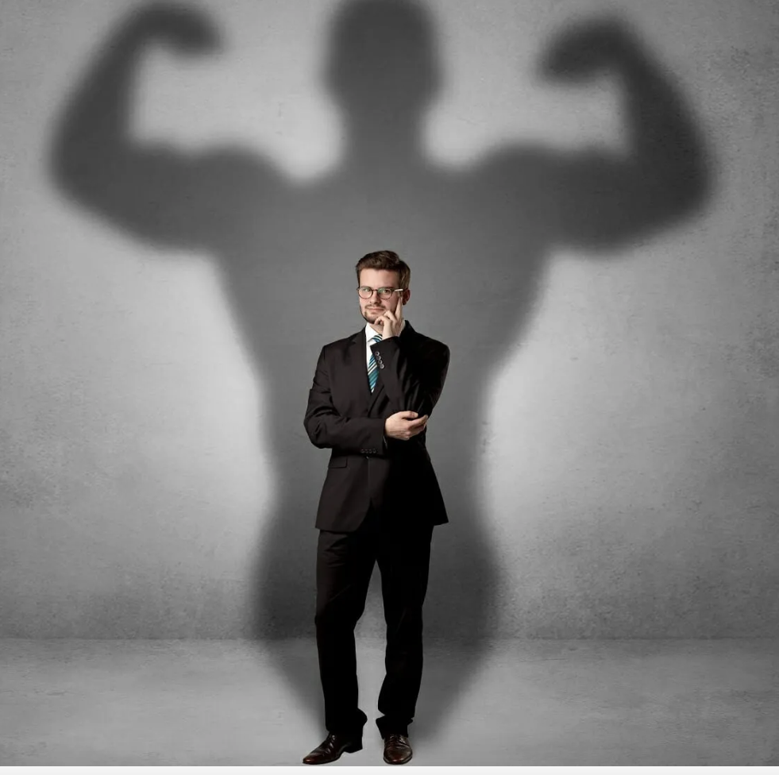
Why do people get these cognitive reflection questions wrong? They’re overconfident about their own gut instinct or intuition.
Notes:
This test isn't really about math skills about about a personality trait - overconfidence in your intuition or gut instinct. You trust the first thing that pops into your head.
More insecure people will test it - even if it feels right.

Slide 16
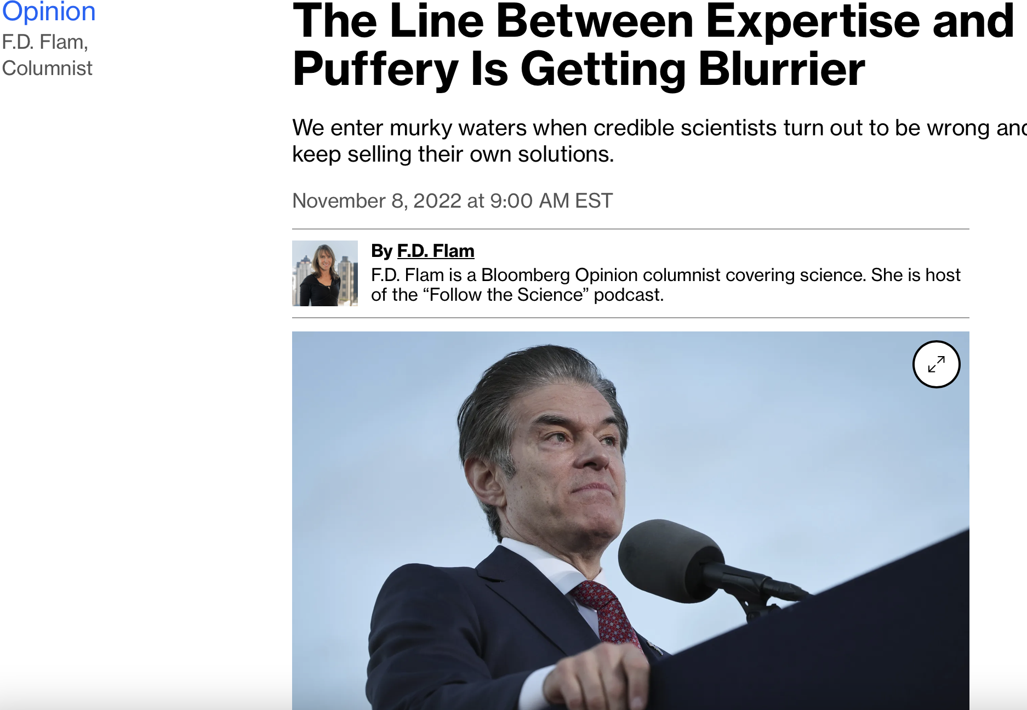
Misinformed people aren’t ignoring experts – they’re finding alternative experts or “alt-thorities”.
Notes:
Here's another column I wrote, from 2022, about the problem with expertise. Historian Edward Tenner calls these people Alt-thorities
Here's Dr. Oz, who is not just a cute TV doctor. He graduated magna cum laude from Harvard, was chair of his medical school class at Penn, and was a renowned transplant and heart surgeon. He also promoted hydroxychloroquine as a cure for Covid after clinical trials showed it didn't work and hawked dubious weight loss supplements on his TV show.

Slide 17
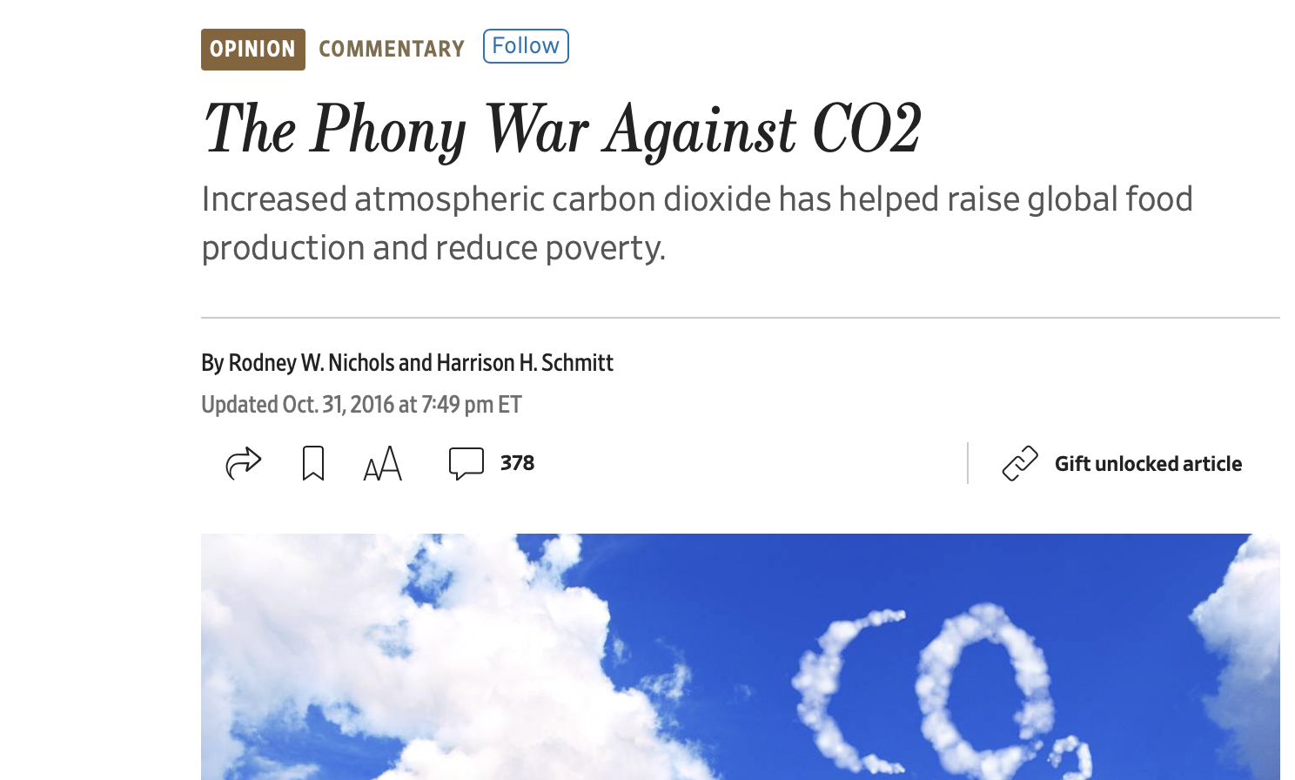
Notes:
Here's an op-ed from the Wall Street Journal that did not age well. It's from 2016. In it the authors claim carbon dioxid can't possibly raise global temperatures more than 1 degree C. But I clipped this because of the authors.

Slide 18
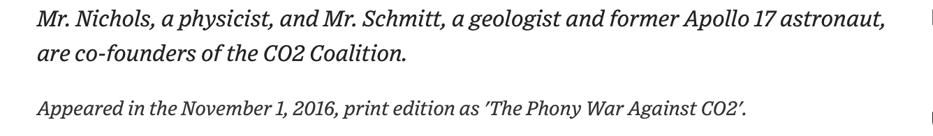
Notes:
The style at the WSJ doesn't give people the title of Dr. but they both are. we have a physicist and also an astronaut - not just any astronaut but the one trained geologist to walk on the moon. So these are people with serious credentials but fringe, contrarian views.

Slide 19
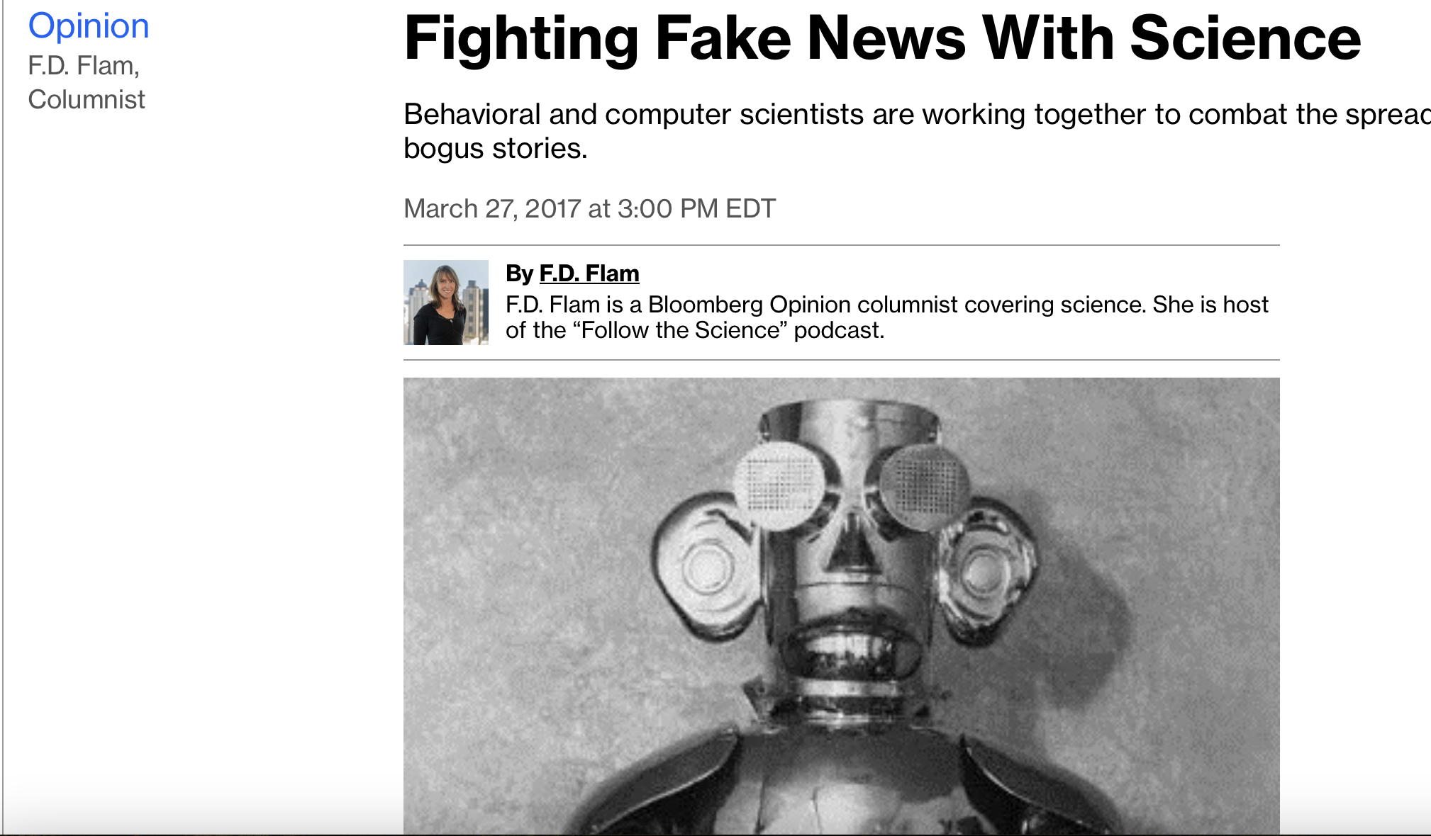
On Social Media, Fake People Wield More Influence and Power than Fake News
Notes:
Fake people are a big deal on social media - researchers refer to them as bots, and they influence us by making ideas and viewpoints look more popular than they are, and people are naturally inclined to gravitate toward things they think other people are paying attention to.
In this column I described an experiment scientists did with birds....bots are doing the same kind of thing to us.

Slide 20
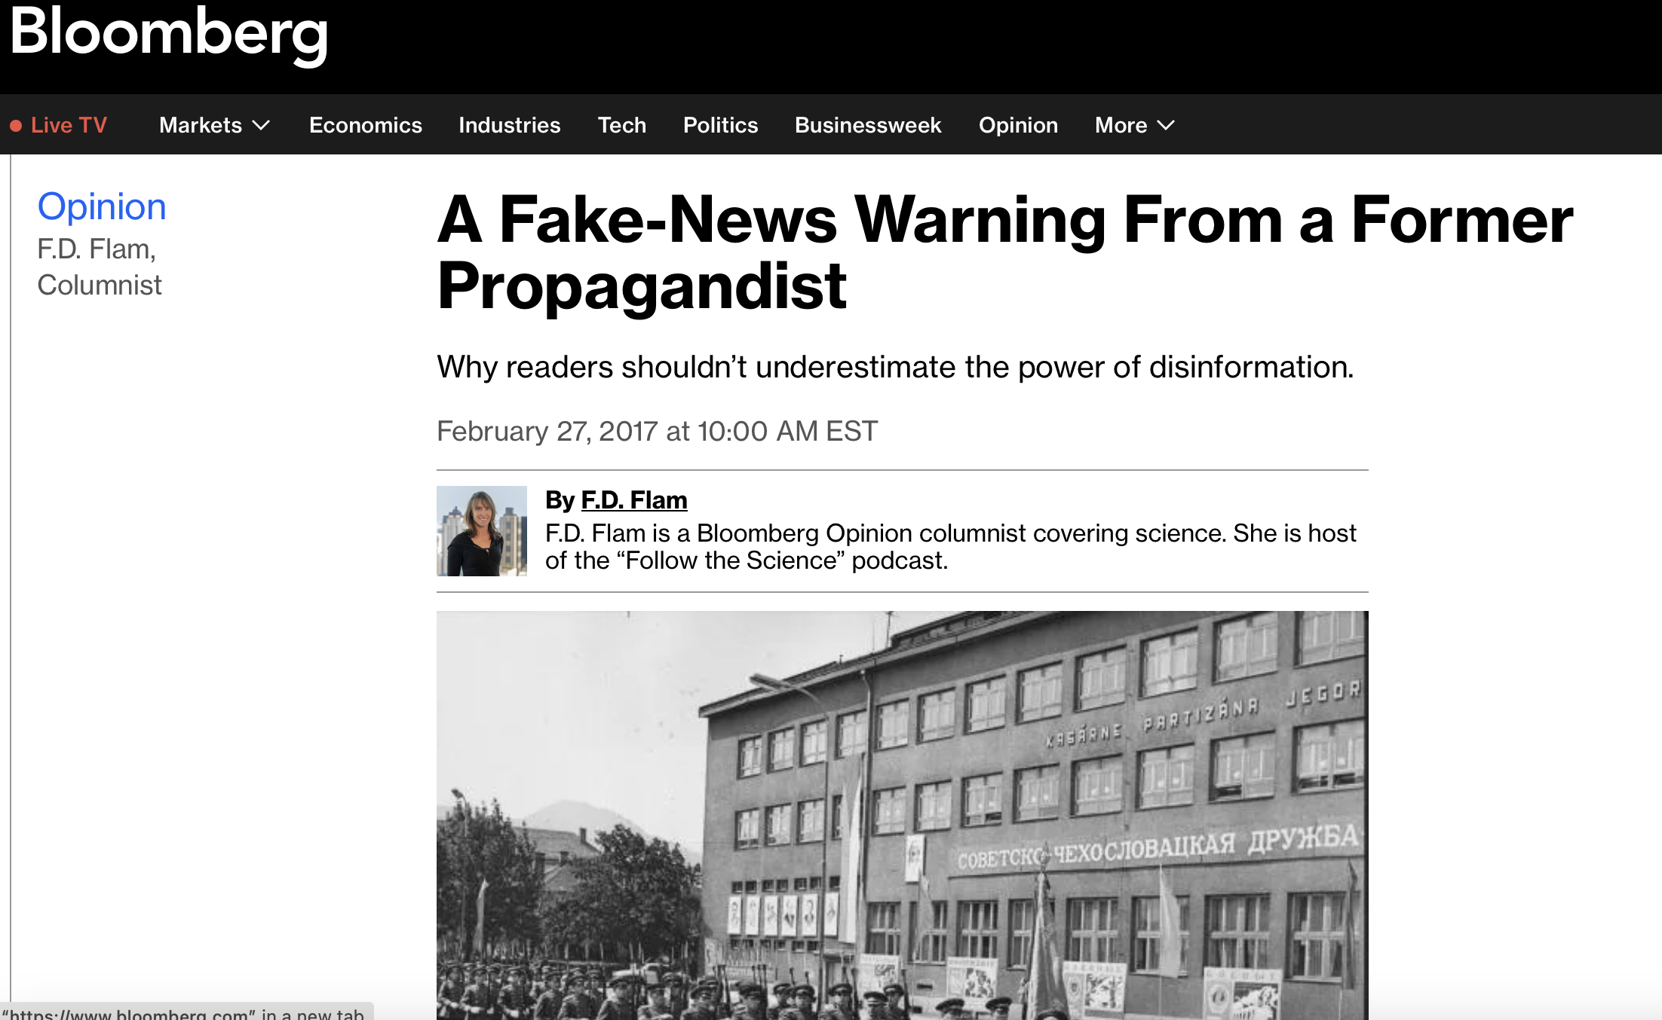
The Most Influential Misinformation is Mostly True
Notes:
I learned that the best misinformation is mostly true from one of the most interesting people I've ever interviewed. Stanislav Bittman was born in Czechoslovakia, and worked as a spy under the soviets where his job was to create disinformation. When things got bad between his country and the Soviets he defected to the US and for a while taught a course at Boston University in how not to fall for propaganda.

Slide 21
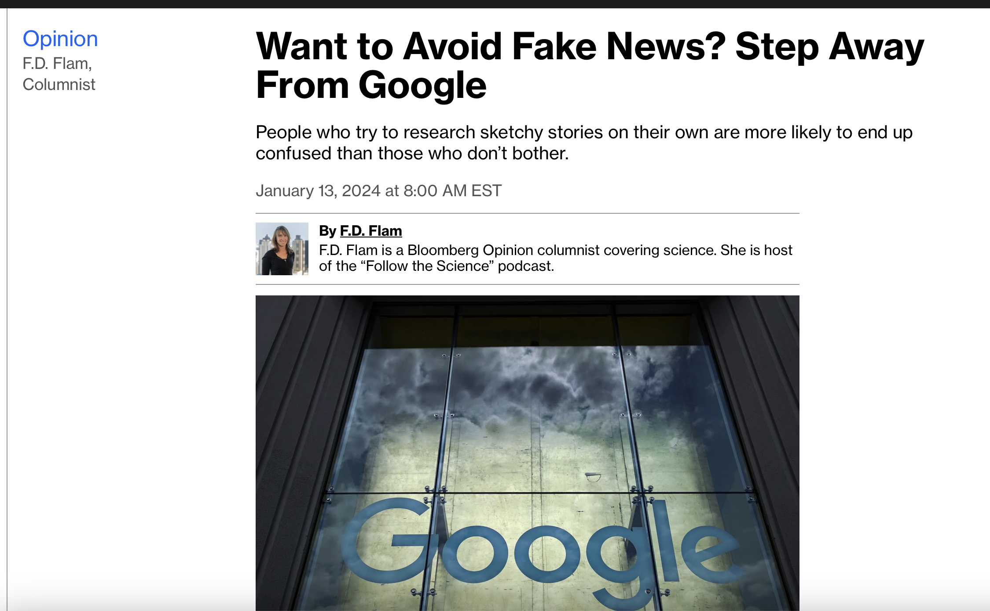
Research on Google often reinforces belief in misinformation
Notes:
People tend to find more sources of the same misinformation but rarely check the credibility of their sources.

Slide 22
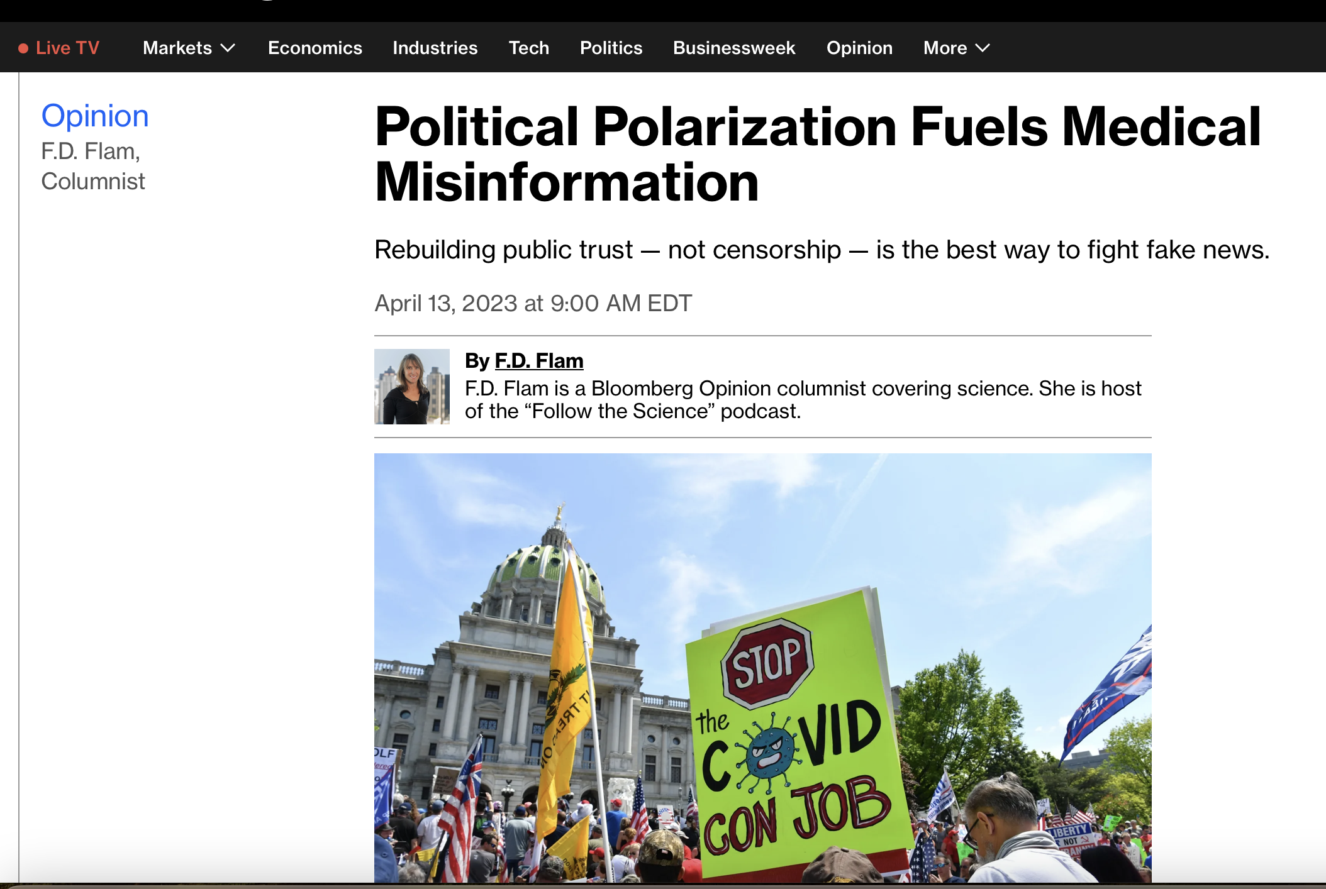
What drives engagement on social media is hurling dirt and insults at the other side – technically called “outgroup derogation.” Whether it’s true or not is irrelevant to those spreading it.
Notes:
For this column in 2023 I talked to researchers about the connection between our political polarization and the misinformation problem. They didn't think people were divided because we're misinformed. It was the other way around.
People posting on social media care not about truth but about scoring points for their political team.

Slide 23
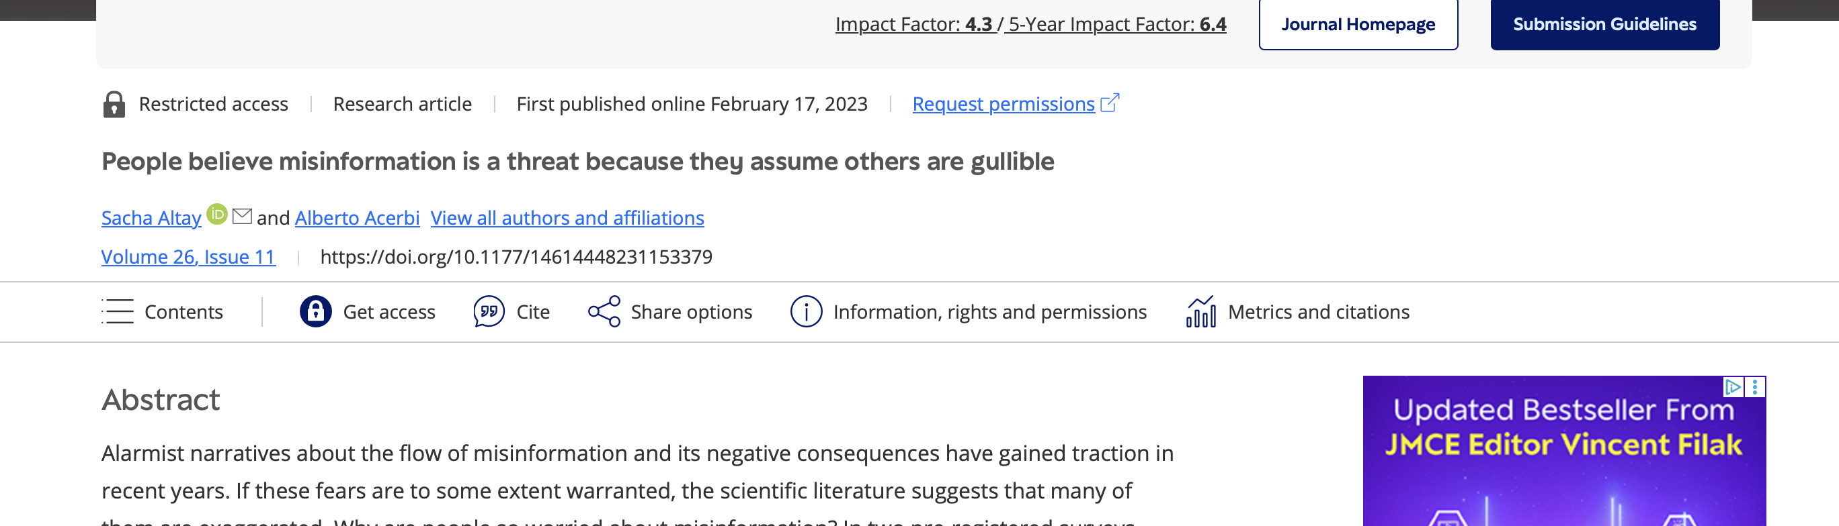
The people who express the most concern about misinformation are the most likely to consider themselves impervious to it.
Notes:
Here's a study I quoted in that column.
........If people thought they were just average at spotting misinformation, they'd assume that if they saw obviously phony stories on social media that other people were also recognizing them as false.
Nobody is worried about being misinformed.

Slide 24
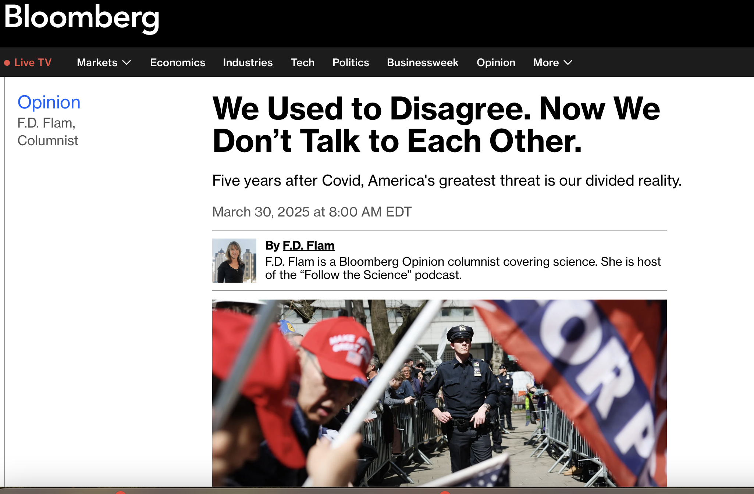
The Pandemic Was a Polarization and Misinformation Tipping Point
Notes:
For this story I talked to a researcher named Mike Macy at Cornell University. We talked about the way most crises brig people together, but the Covid pandemic had the opposite effect. Some of this happened because people in the middle risked getting beaten up by both sides, and so tend to retreat to the safety of the left or the right.

Slide 25

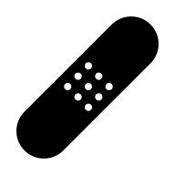
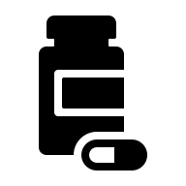
How to fix the situation
Is there a cure for our misinformation and deep division?

Slide 26
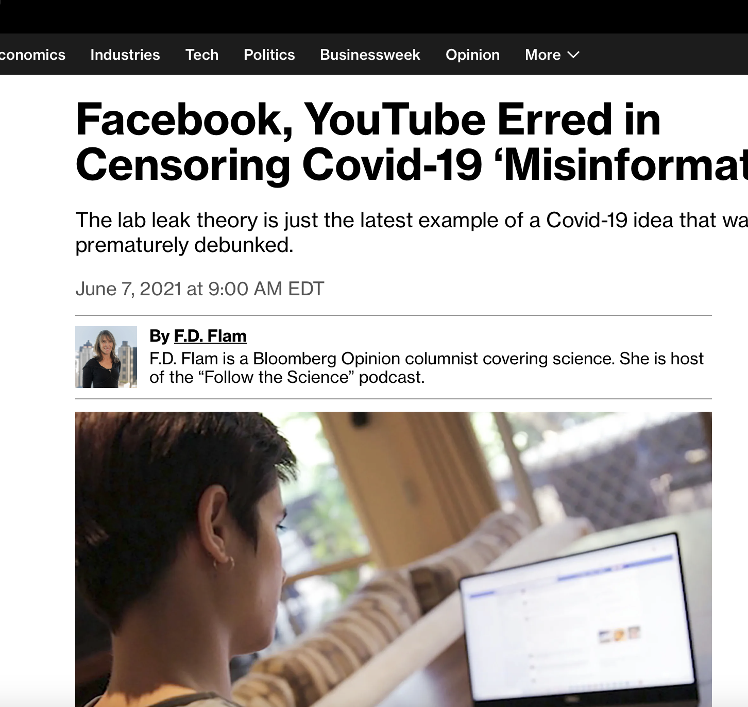
The Problem with Censorship
Notes:
People certainly have the right to censor hateful language or racism on their own social media platforms, but there's a problem that comes up when you try to censor misinformation - sometimes the censors get it wrong.
A striking case was Facebook censoring speculation that the pandemic virus didn't come from a wet market but from a lab. The reality was the scientific community never had a good idea where this virus came from and the case for the wet market was far from airtight. It wasn't clear it was the origin or site of superspreading event.
Suppression of information on such an important question led to a real collapse in trust - not just trust in Facebook, which wouldn't be a bad thing, but trust in the goverment, science and the media in general.

Slide 27
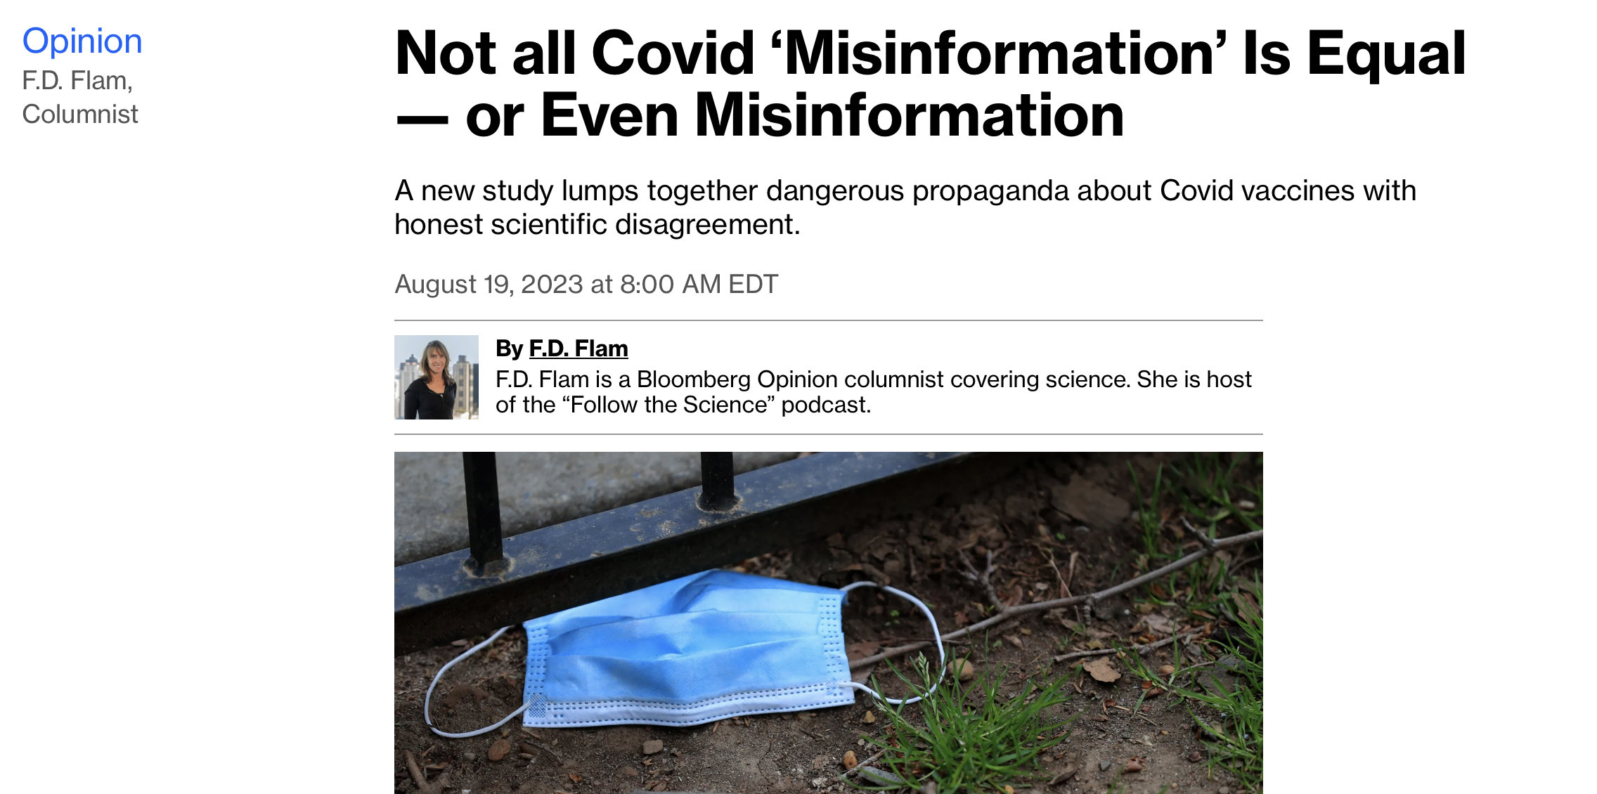
The Trouble With Fact Checkers. They sometimes get the facts wrong. (or use motivated reasoning.
Notes:
And a similar problem can crop up with fact checking - this is a column I wrote about the way some experts misidentified misinformation about the pandemic.
Again, how do people know they have the truth? How do they know the other side is wrong? ....

Slide 28
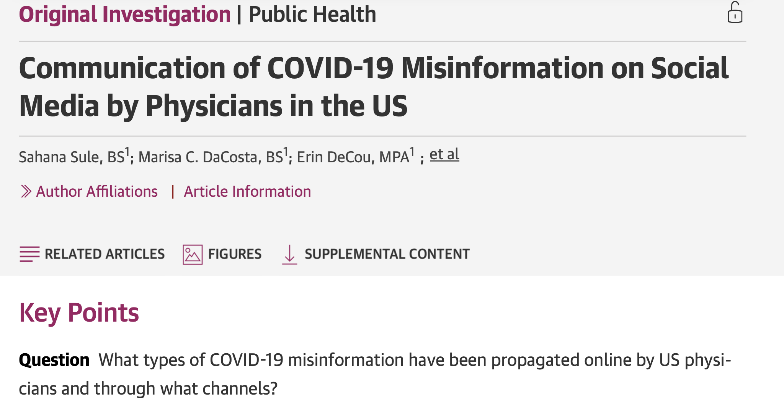
Notes:
The column was based on this study, which is about alleged misinformation being spread by rogue doctors on Twitter and Fox News. But if you look at the data.....some of the "misinformation isn't wrong.

Slide 29
"What they did is they covered it up... When they knew full well that so many of the top virologists in the world believed that the lab leak was a real possibility.”
-------
61% of patients who tested positive in BreatheMD last month were vaccinated.
---------
"It's time to recognize natural immunity as at least as good as vaccination and end the mandates." (Facebook, 2/4/22, anesthesiology)
----------
Are these really misinformation? By whose definition?
Notes:
Top: That's pretty much what had come out of all those FOIA requests - top virologists did indeed worry about a lab leak.
If most of the patients at this health center were vaccinated then it's pretty likely that this is right. The vaccine isn't very effective at preventing infection.
Finally, it was understood from the start, by immunologists that this virus left people with some protectve immunity. That's the reason the vaccine works.

Slide 30

What do we mean by misinformation??
Is it information that contains misleading statements, or falsehoods, or anything that interferes with genuine understanding?
Or is it information that might be true but deviates from official messaging?
We need to talk about this if we want to combat misinformation
Notes:
What was going on? I came to suspect that the authors of the paper were defining misinformation differently.
Or is it 2: They thought people needed a very simple message - vaccines work, and so anyone pointing out the limitations of the vaccine is spreading misinformation.
This is a very serious disagreement and we need to talk about this. I happen to think we should use the first definition - about falsehood. There's some scientific evidence from a field called risk communication that shows honest is the best policy for saving lives in a crisis. it may also be problematic for democracy to allow individuals to define truth and misinformation.

Slide 31

People can understand nuance if they’re told a story. The brain is wired to understand stories, not oversimplified slogans.
What if instead of suppressing information on Ivermectin, we told the whole story of this drug : How it was invented, why some suspected it might be a good treatment for Covid, how it was tested in people and what those tests showed?
Notes:
Telling Stories. One word I kept hearing during the pandemic was nuance - which was assumed to be something the public was too stupid to comprehend. But people are wired to listen to stories.
In defense of people who believe it worked, Covid can be extemly mild and can go away quickly in some cases, so people who took this drug might credit it with the mildness and fast recovery.

Slide 32
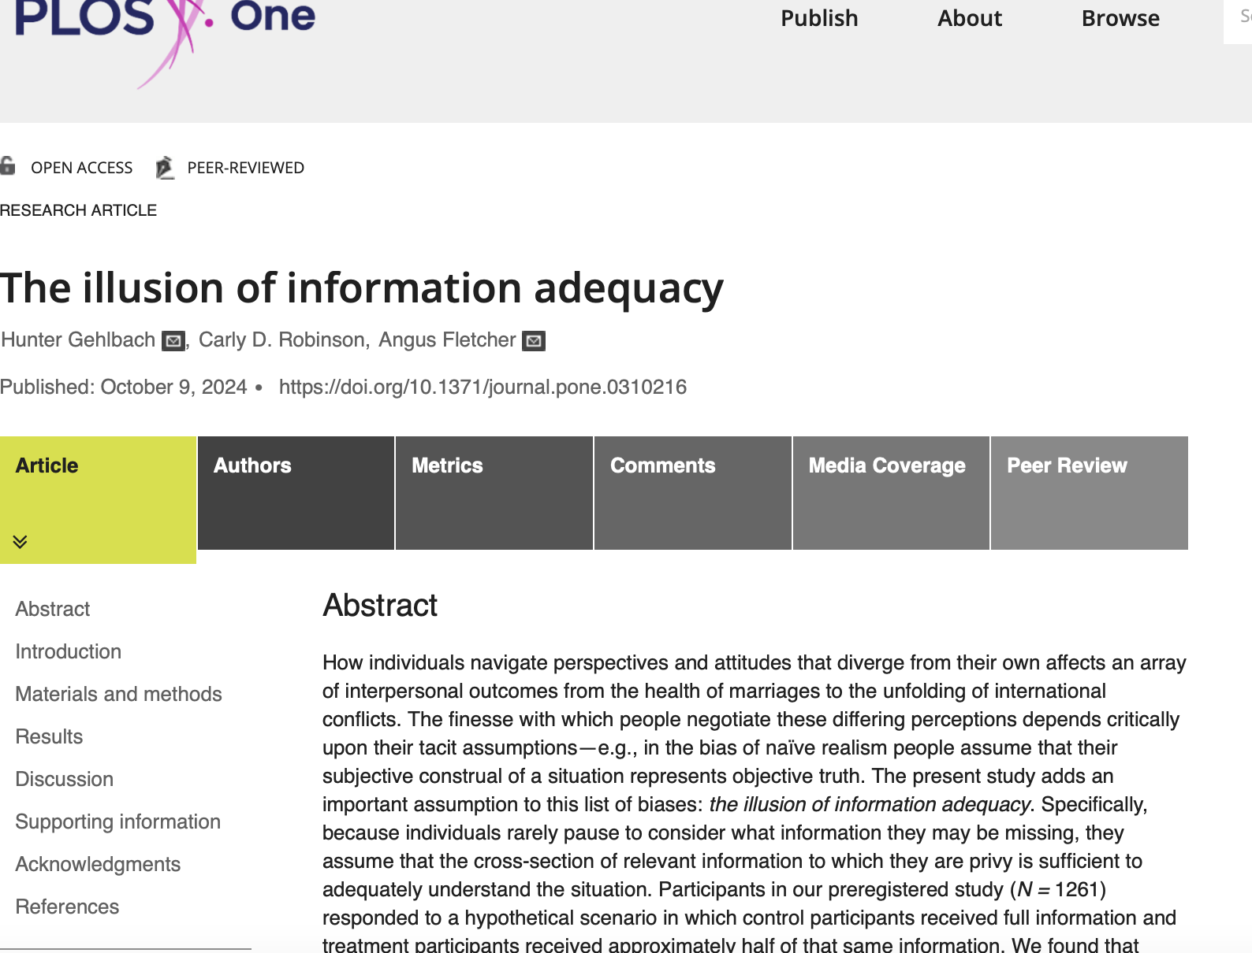
Notes:
This slide shows a fascinating study I wrote about - it involves the value of more information. The researchers gave people a story involving a school that depended on an aquifer that was drying up. They could merge or stay independent.
........In the end they called the effect the illusion of information adequacy - people with half the story don't know what they don't know.

Slide 33
Nudges??
Investigators tested over 3,000 US participants on their ability to spot fake news stories with a political bent……
… people tend to discount facts that cast political rivals in a positive light. But just the promise of $1 per right answer improved volunteers’ accuracy by 30%.
Notes:
As other studies have shown, people often go along with rumors that make their percieve enemies look bad, even if they don't really believe them. If you pay people however, even just a dollar, they will improve dramatically in how well they can distinguish fake news from genuine news stories.

Slide 34
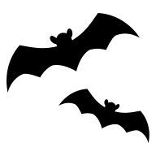



Let’s reconsider our polarization
What if Trump had said he knew for a fact the pandemic virus didn’t come from a lab, it came from an illegal wet market where people were eating weird animals?
What if Trump had said schools should stay closed because we have to keep those gross germ-infested kids away from people? School is lame – he never paid any attention in school and look where he is now!
Notes:
One of the researchers I've interviewed, Mike macy of Cornell, found many issues could be associated with either the political right or left - that there was a randomness to it. he have people issues such as teaching classic books in school or use of AI, and found people would take whichever position aligned with their political tribe. And that got me thinking.....

Slide 35
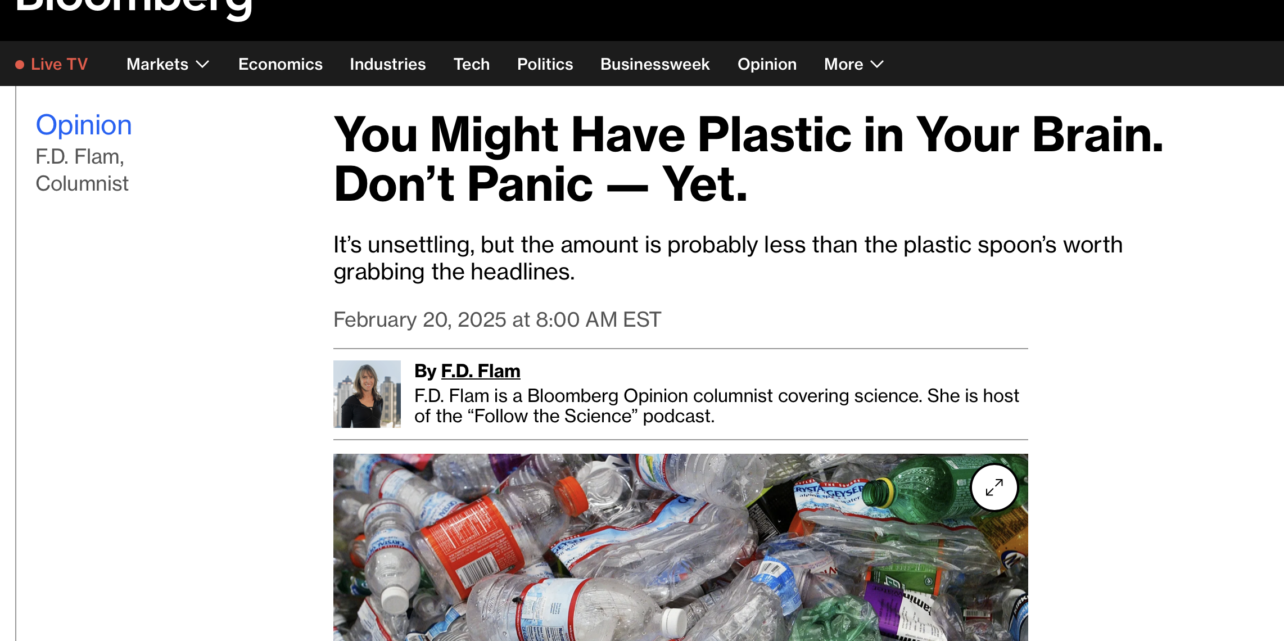
Choose Reliability Over Attention-grabbing power- because mistakes happen but not everyone corrects the record.
Notes:
The other solution is to promote reliability over clickabilty. Here's a column I wrote in early 2025, and it's the topic I'm researching
for my next column.
There's been another rebuttal, which is why I'm revisiting it. Everyone makes mistakes but only a few journalists still go back and try to keep correcting the record. People used to subscribe to newspapers partly for reliability. newspapers may be dying but there's still an important role in our future for reliability.

Slide 36
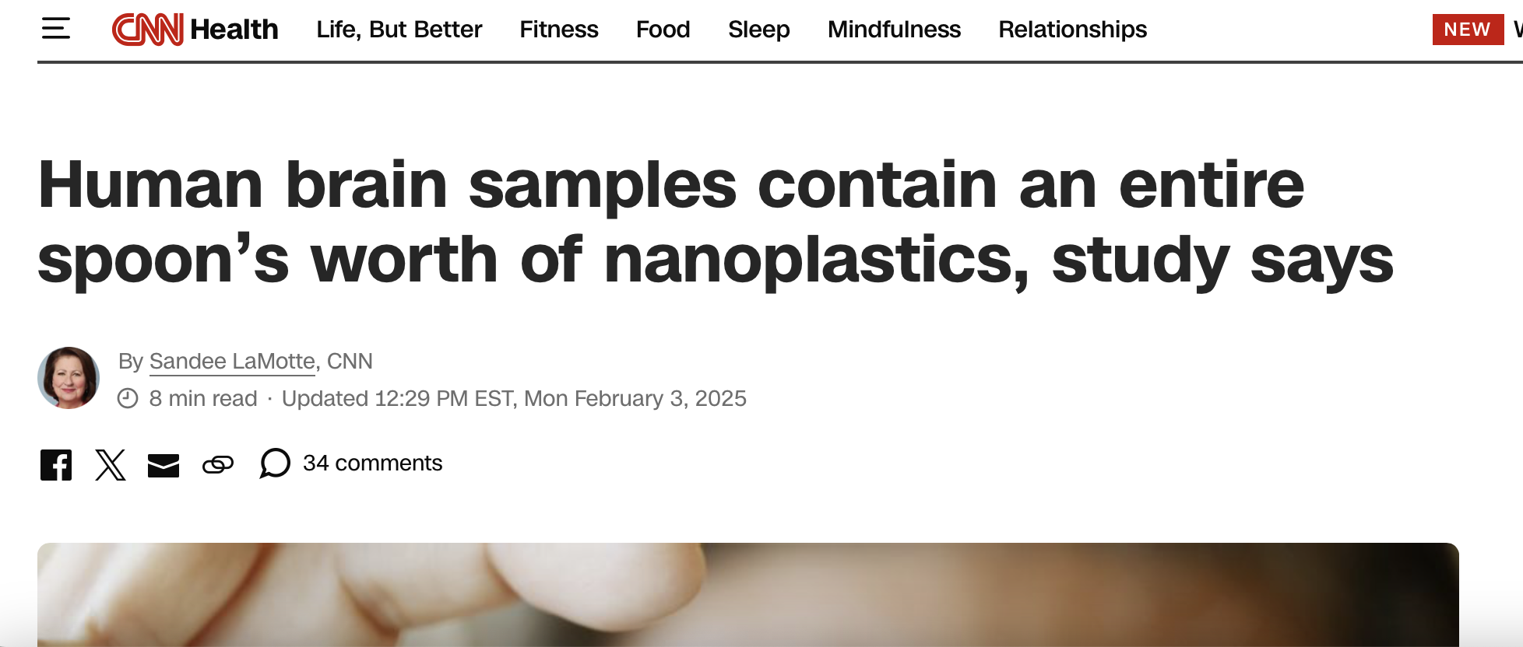
The Algorithms Love This Stuff – but chemists say it’s complete B.S.

